Slide 1
World Expo & Olympics in Barcelona
By Alyssa Larsen and Vance Kleemeyer

Slide 2
The 1929 World Expo
Also Known as the Barcelona International Exposition
Idea was proposed by architect Josep Puig i Cadalfach
The Expo was a way to bring countries together, despite the bitter relationships some countries had during the time period.
Also was a way to show the world Spain’s development
https://www.youtube.com/watch?v=xz0vFULyDFc

Slide 3
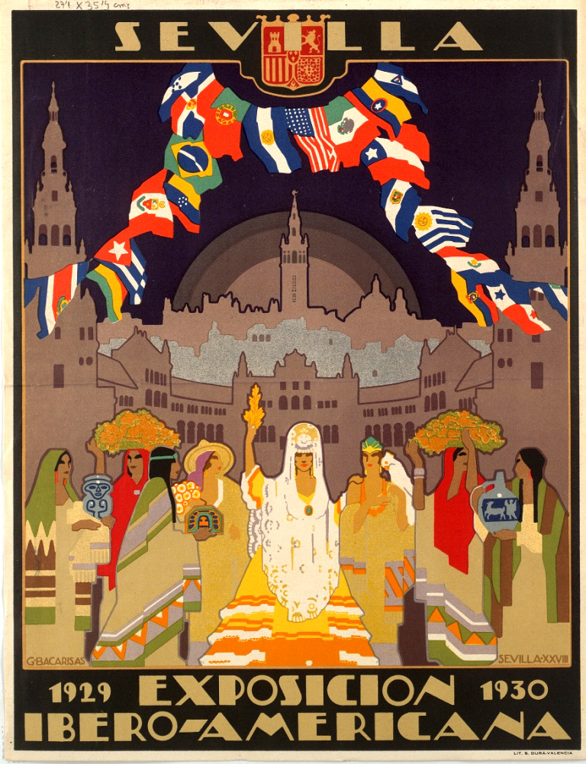
The Expo Itself
The expo took place from May 20th 1929- January 15th 1930
Over 20 European nations(France, Britain, Germany, Italy), as well as private organizations from the United States and Japan attended
Over 200,000 visitors attended
Impressive, being between two world wars

Slide 4
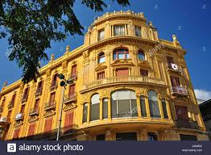
The Expo Itself Cont.
The expo had three section: Art, Sports and Industry
A lot of buildings and structures were needed to be built
Resulted in architectural advances
Architectural movement known as the “Noucentisme” meaning 19th century

Slide 5
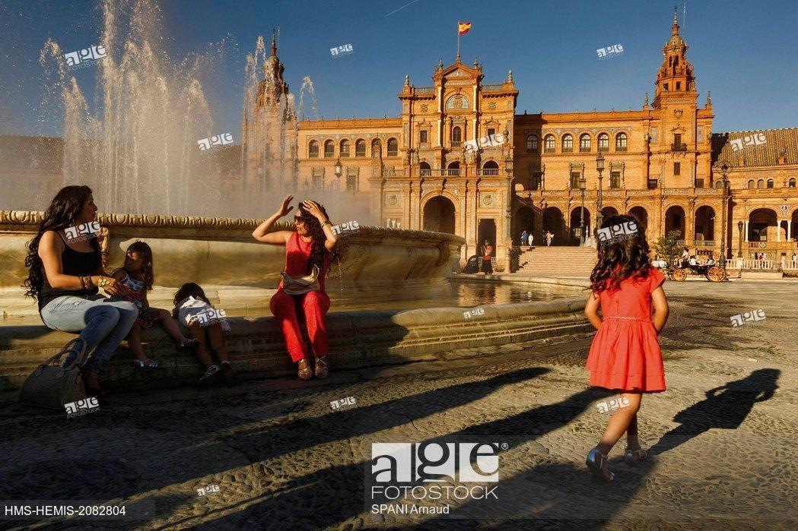
The Expo’s Impact
Eased some tension going on in the world
Showed Spain wasn’t the only developing country
Made Barcelona more appealing to tourists
So much more!

Slide 6
The 1992 Barcelona Summer Olympics
https://www.youtube.com/watch?v=Gkmg79ApRNQ
Opening ceremony shows the energy and culture of Barcelona
Fun Facts about the lighting of torch
Lit by Antonio Rebollo, a disabled Spanish archer (polio)
Known as the greatest Olympic cauldron lighting
“THE GAMES IN BARCELONA TRANSFORMED THE PROUD CATALAN CITY. TWENTY-FIVE YEARS AGO, THE ATMOSPHERE FOR THE GAMES WAS MAGNIFICENT, UNFORGETTABLE. AS WAS THIS MOMENT OF PURE MAGIC WHICH CONCLUDED THE OPENING CEREMONY”

Slide 7
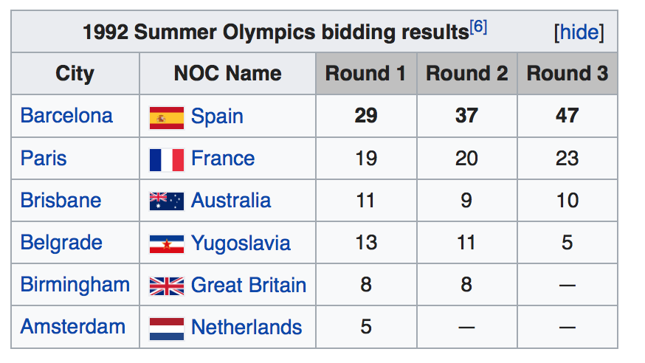
The 1992 Barcelona Summer Olympics
Officially known as the Games of the XXV Olympiad
July 25th to August 9th 1992
The 1992 Summer Olympics in Barcelona were the last competition to be staged in the same year as the Winter Olympics, they began to alternate even numbered years

Slide 8
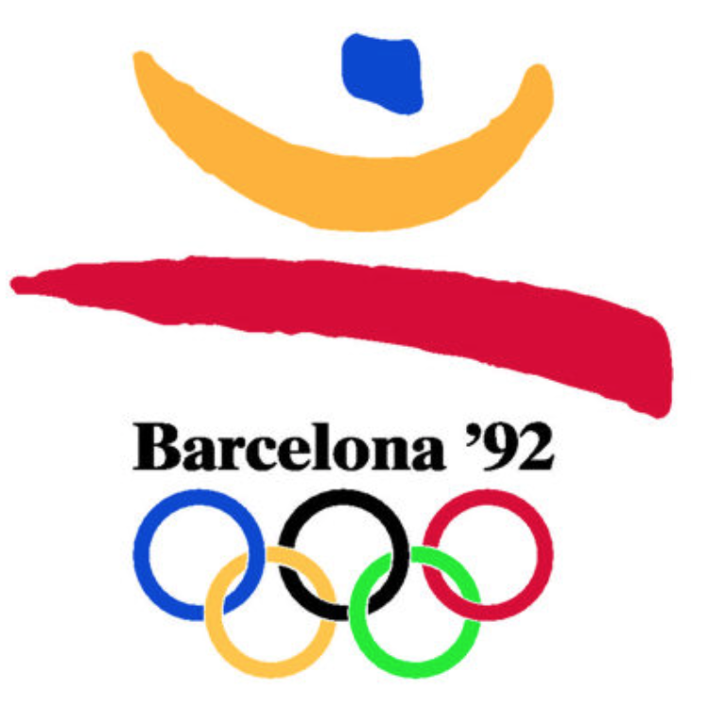
Impact of the 1992 Olympic Games
The summer when Barcelona dazzled the world!
“Barcelona was catapulted into cosmopolitan resort on the Mediterranean and by the end of the 90s had become one of Europe’s most visited cities, behind London, Paris and Rome”
New sites Barcelona developed
Twin towers of the Arts Hotel and Mapfre Tower (the tallest buildings in Spain when built) which was built specifically for the 1992 Olympics. Athletes stayed there but now is known as one of the nicest hotels in the city.
The remodeling of the seafront, including Barceloneta beach
The building of the Olympic Stadium
“The 1992 Summer Olympics in Barcelona were an enormous success, both as an international sporting event and as the catalyst for wide scale urban renewal of Barcelona the city…”
https://www.hotelartsbarcelona.com/en/hotel-rooms/

Slide 9
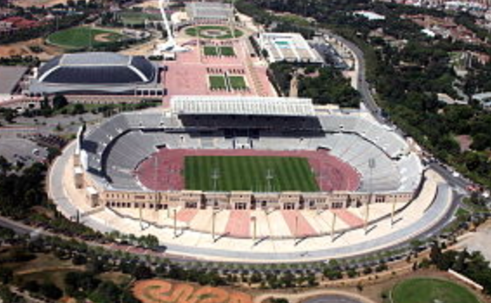
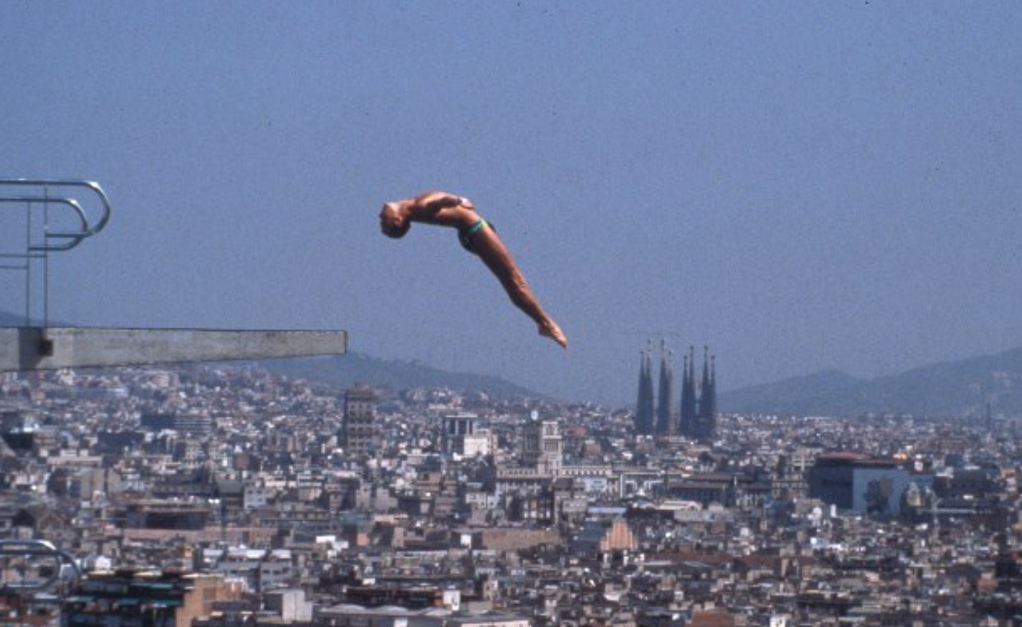
Other Fun Facts of the 1992 Olympics
China’s Fu Mingxia won the high dive event at the age of 13, held in view of Gaudi’s La Sagrada Familia
Germany sent a unified team for the first time since 1964
South Africa was allowed to compete for the first time since 1960 after finally ending the system of segregation based on race
Obvious rise in employment during the games, and after with the new facilities built
The 1992 Summer Olympics “led to a rise in local pride, and a huge increase in the desirability of living in and visiting the city”

Slide 10
Sources
https://www.olympic.org/news/the-magic-moment-of-the-barcelona-games-opening-ceremony
https://www.nytimes.com/1992/05/15/sports/sports-people-olympics-archer-to-light-barcelona-s-flame.html
https://en.wikipedia.org/wiki/1992_Summer_Olympics
https://www.barcelona-life.com/barcelona/1992-olympic-games
https://en.wikipedia.org/wiki/Ibero-American_Exposition_of_1929#/media/File:Expo_sevilla_1929_poster.jpg
https://theculturetrip.com/europe/spain/articles/thelegacy-of-the-1929-barcelona-international-exposition/
https://www.alamy.com/stock-photo/noucentisme.html
https://www.agefotostock.com/age/en/Stock-Images/Rights-Managed/HMS-HEMIS-2082804

