Slide 1
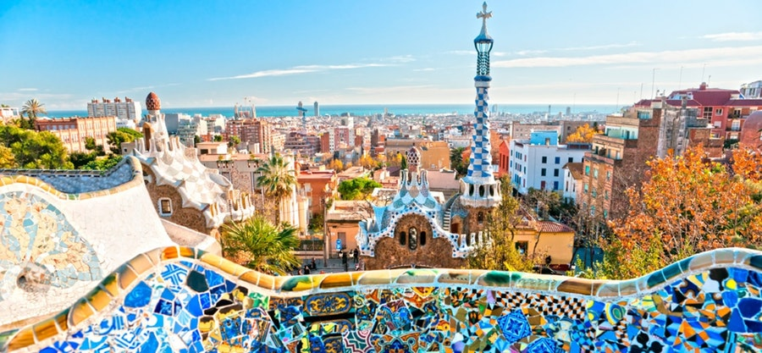
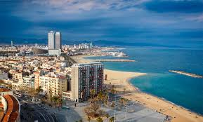
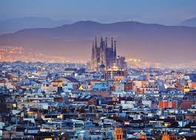
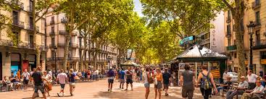
Road Map of Spain
Moira Conville

Slide 2
Spain

Slide 3
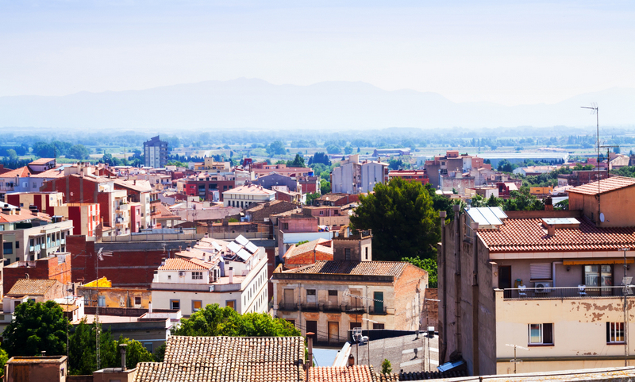
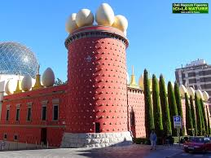
Figueres
Catalan for fig trees
The capital of the comarca of Alt Empordà in the province of Girona, Catalonia, Spain
This town is the birthplace of artist Salvador Dalì
During the Spanish Civil War, Figueres remained loyal to the Republican government, but then was bombed by rebels. In the 1950s, the town started to recover from this devastating event by promoting its tourism economy

Slide 4
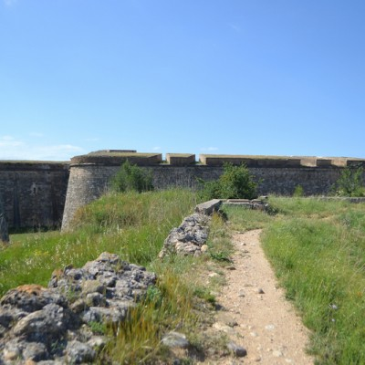
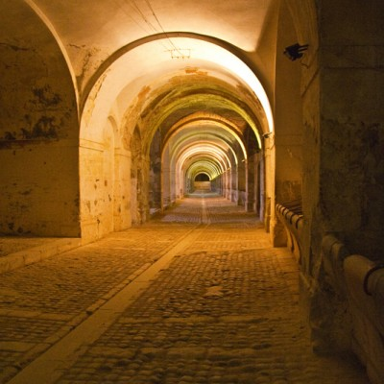
Figueres
Sant Ferran Castle Figueres
Built in the 18th century, this castle has been well preserved
Tourists can walk around the outside for free or for €3, you can enter the castle for an interior tour which includes an audio guide

Slide 5
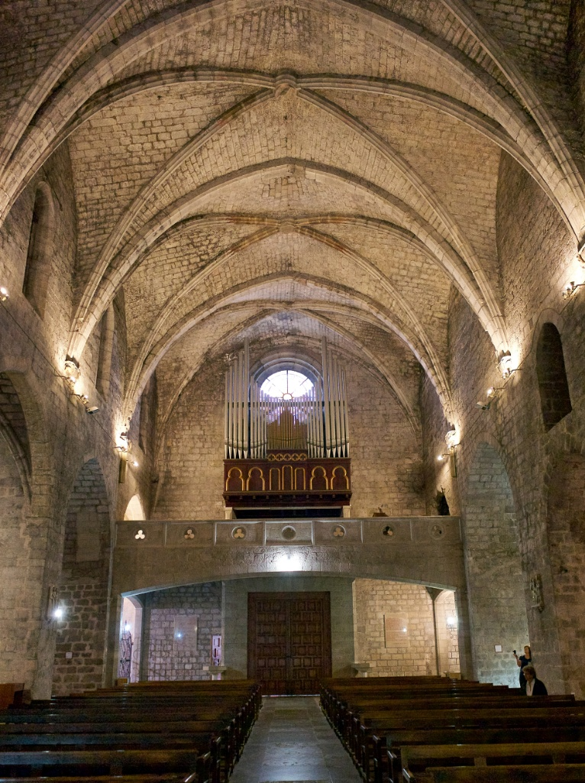
Figueres
Saint Peter’s Church Figueres
Constructed in the late 14th century by Peter IV of Aragon
Some of the oldest remains that have been preserved date back to the 11th/12th centuries
Restoration efforts occurred from 1940s-1950s
This is the church where Dalì was baptized

Slide 6
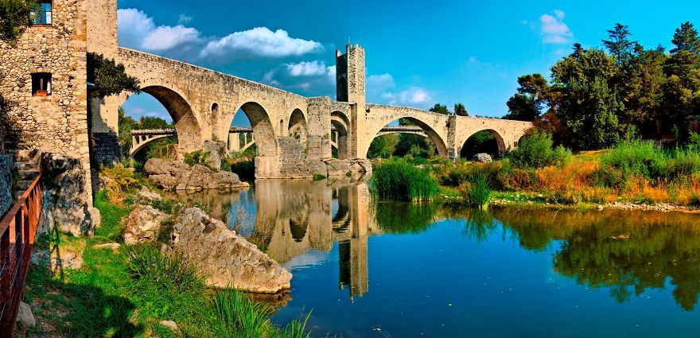
Besalú
Besalú is a town in the comarca of Garrotxa in Girona, Catalonia, Spain
Besalú was designated as a historical national property in 1966
The town’s most significant feature is its 12th-century Romanesque bridge over the Fluvià river which is called Punete de Besalú

Slide 7
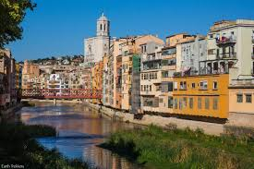
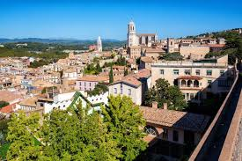
Girona
Girona is a major city in Catalonia, Spain at the confluence of the rivers Ter, Onyar, Galligants, and Güell
Alfonso I of Aragon declared Girona a city in the 11th century
Girona has undergone twenty-five sieges and been captured seven times

Slide 8
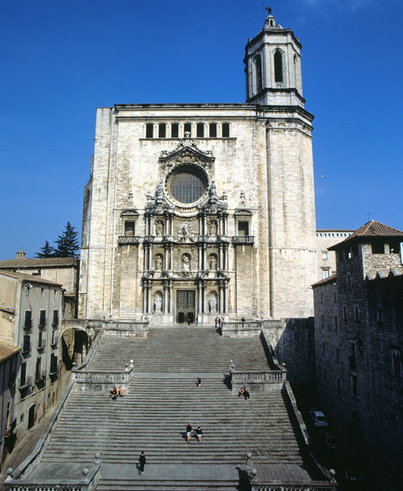
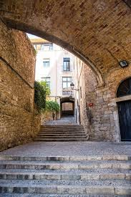
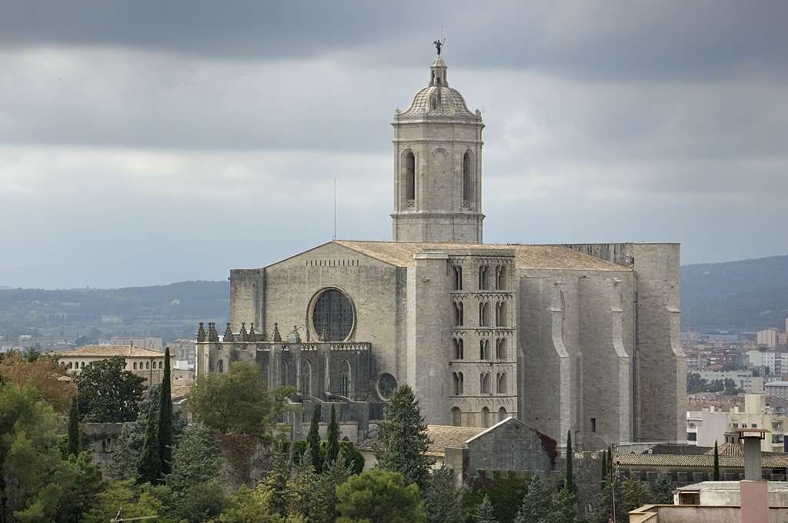
Girona
The Jewish Quarter
From 982 to 1492, there was a strong Jewish presence in Girona
An area where they lived, called El Call, is a maze of narrow, cobblestone lanes is fun to explore
Girona Cathedral
Very popular tourist attraction that dominates the skyline of Girona
It is perched on top of a hill, so the only way into the cathedral is to climb the long staircase

Slide 9
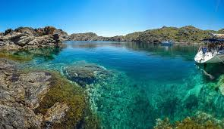
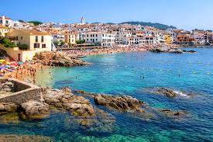
Costa Brava
Costa Brava is a coastal region of Catalonia in northeastern Spain, consisting of comarques of Alt Empordà, Baix Empordà, and Selva in the province of Girona
Costa Brava stretches from the town of Blanes 60 km from Barcelona to the French Border
The combination of a great summer climate, nature, and the beautiful beaches made Costa Brava an attractive tourist destination

Slide 10
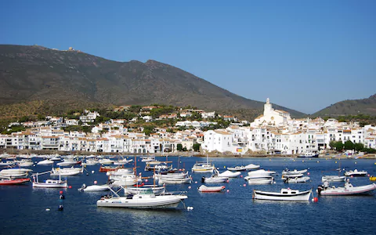
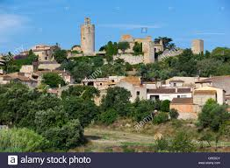
Costa Brava
Pals
One of the most charming villages on the Costa Brava
Declared a site of historical interest in 1973
Cadaqués
This white village with its gorgeous surroundings that inspired artist Salvador Dalí
This town is rich is architecture and home to the famous House-Museum of Daí

Slide 11
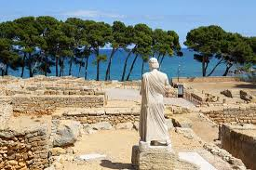
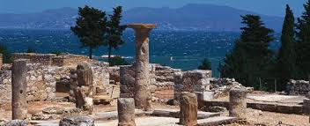
Roman Ruins in costa Brava
The Ruins de Empuries are Greek and Roman ruins situated right behind the beach of Sant Marti de Empuries
The Empuries Ruins are an ancient port city, known to Greeks as Emporion (meaning market) who created the city in the 6th century BC and to the Romans as Emporiae, who created a new city at the same location at the beginning of the 1st century BC
The Empuries Ruins were discovered in 1908 and excavations are presently still happening

Slide 12
References
http://www.catalonia-valencia.com/besalu-spain-travel-guide.html
https://www.earthtrekkers.com/best-things-to-do-girona-spain/
https://www.spain-holiday.com/Costa-Brava/articles/beautiful-costa-brava-towns-visit
http://www.real-costa-brava.com/ruins-empuries-things-to-do.html

